Slide 1
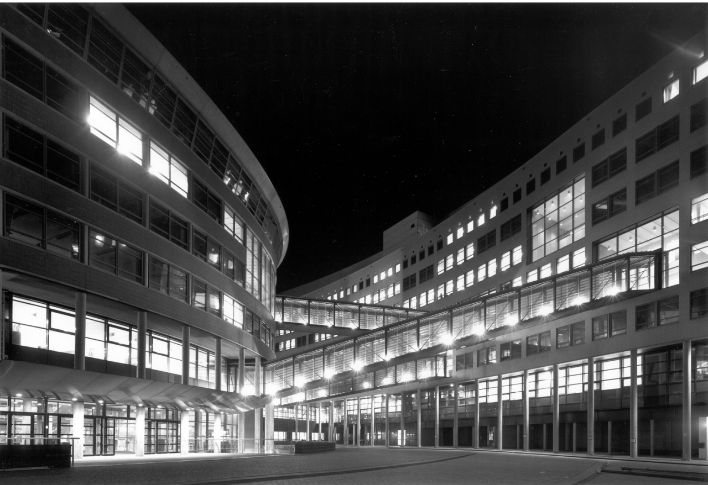


OPSCHALER
Progress Week 4
[1] 21-9-2018

Slide 2


Contents
Introduction
Research questions
Recap sprint 2
Receiving data
Data cleaning and transforming
NaN checker
Sprint 3
Apply regression
Linear, multivariate
Meeting at TU Delft
Q&A
[2]

Slide 3
Introduction
Forecasting energy consumption
Predict the activity of people in their homes
[3]

Slide 4
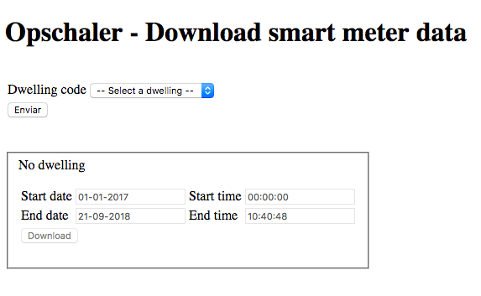



Receiving data
[4]

Slide 5

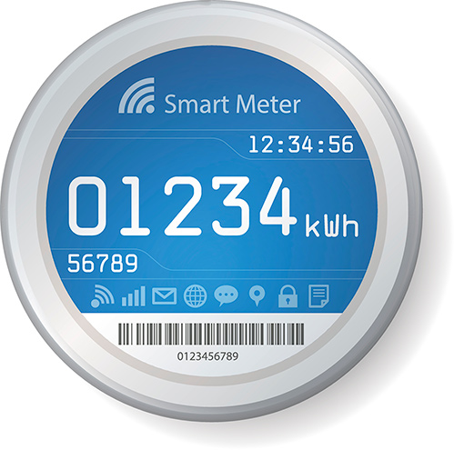


Data cleaning & transforming
X61
Dataframe per house
Exploratory Data Analysis
[5]

Slide 6
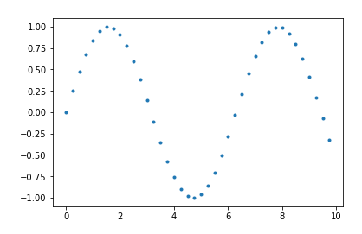
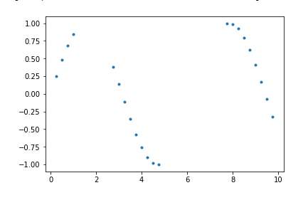
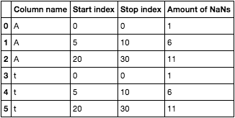
Data cleaning & transforming
[6]

Slide 7
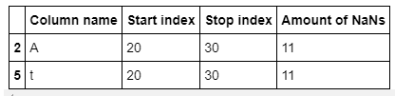
Data cleaning & transforming
Filter output based on NaN streaks being larger than x % of the total length of the dataframe.
[7]

Slide 8
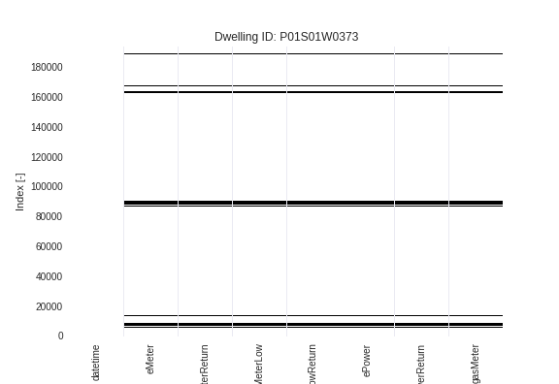
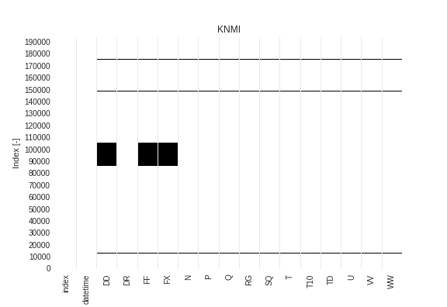
Data cleaning & transforming
[8]

Slide 9
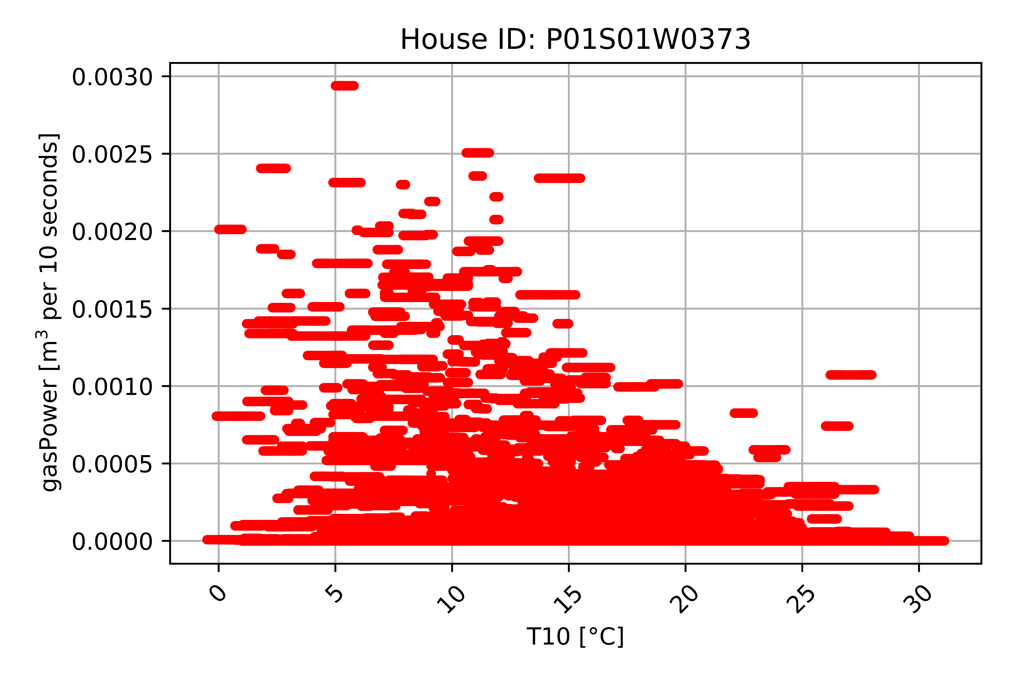
Sprint 3
- Apply regression
- Linear, multivariate
- Meeting at TU Delft
[9]

Slide 10
Any questions?
7-9-2018

